Slide 1

Chapter 6
IP Security
Henric Johnson
Blekinge Institute of Technology, Sweden
http://www.its.bth.se/staff/hjo/
henric.johnson@bth.se

Slide 2
Outline
Internetworking and Internet Protocols (Appendix 6A)
IP Security Overview
IP Security Architecture
Authentication Header
Encapsulating Security Payload
Combinations of Security Associations
Key Management

Slide 3
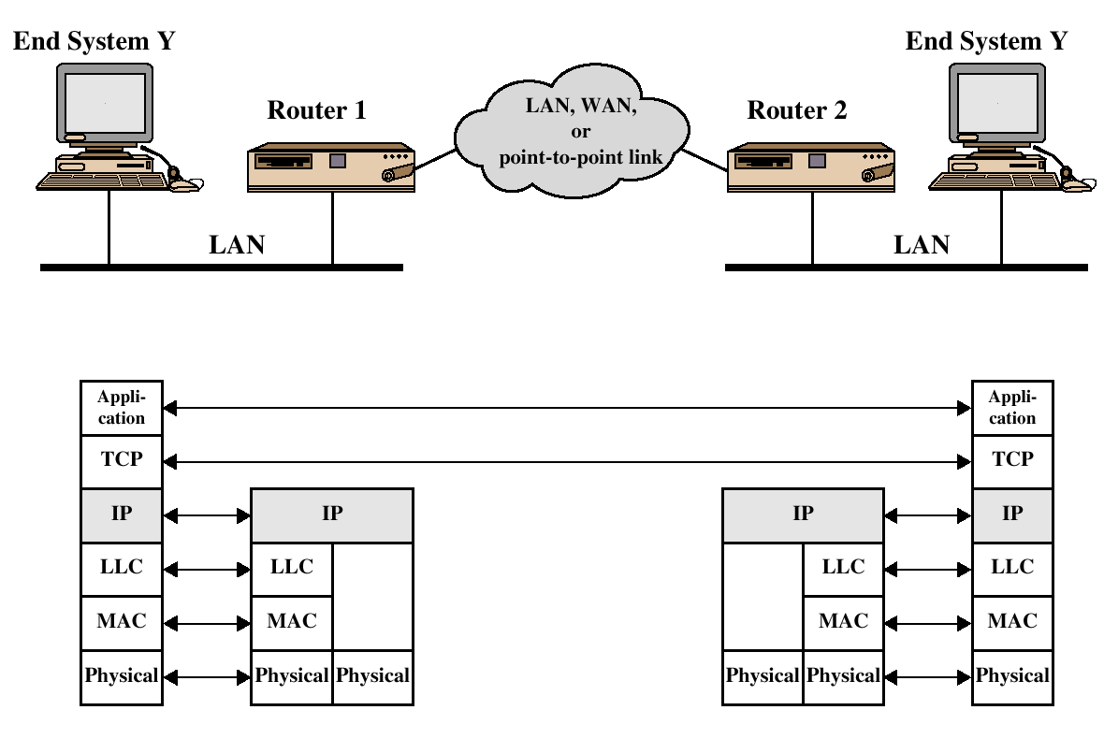
TCP/IP Example

Slide 4
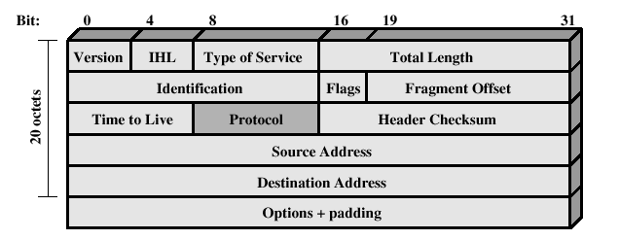
IPv4 Header

Slide 5
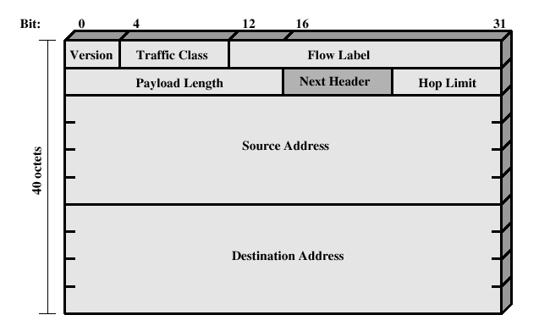
IPv6 Header

Slide 6
IP Security Overview
IPSec is not a single protocol. Instead, IPSec provides a set of security algorithms plus a general framework that allows a pair of communicating entities to use whichever algorithms provide security appropriate for the communication.

Slide 7
IP Security Overview
Applications of IPSec
  Secure branch office connectivity over the Internet
  Secure remote access over the Internet
  Establsihing extranet and intranet connectivity with partners
  Enhancing electronic commerce security

Slide 8
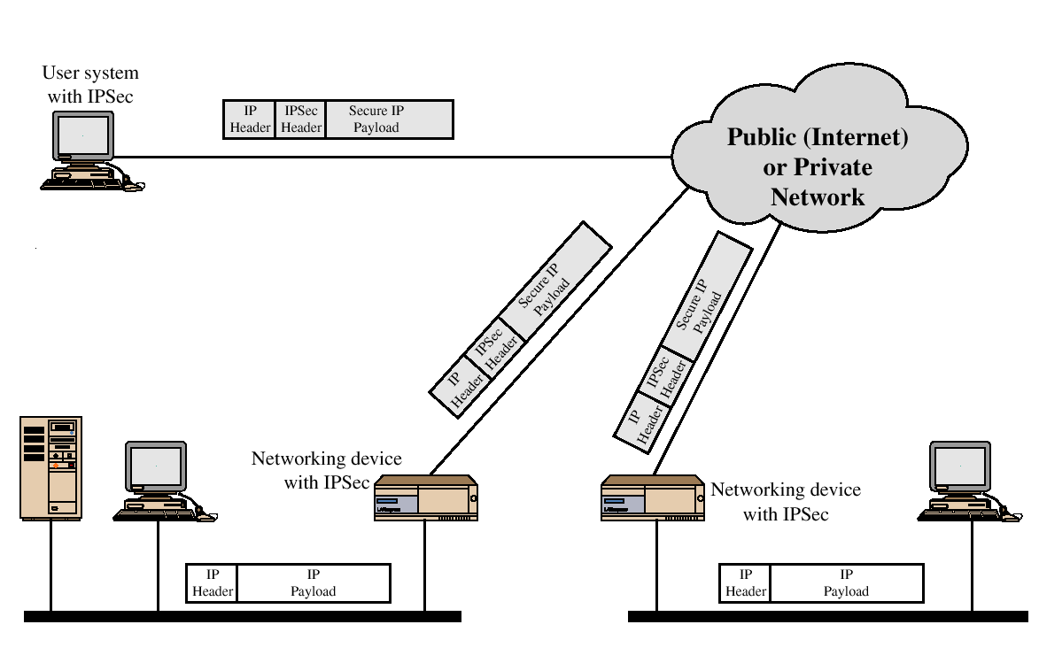
IP Security Scenario

Slide 9
IP Security Overview
Benefits of IPSec
  Transparent to applications (below transport layer (TCP, UDP)
  Provide security for individual users
IPSec can assure that:
  A router or neighbor advertisement comes from an authorized router
  A redirect message comes from the router to which the initial packet was sent
  A routing update is not forged

Slide 10
IP Security Architecture
IPSec documents:
  RFC 2401: An overview of security architecture
  RFC 2402: Description of a packet encryption extension to IPv4 and IPv6
  RFC 2406: Description of a packet emcryption extension to IPv4 and IPv6
  RFC 2408: Specification of key managament capabilities

Slide 11
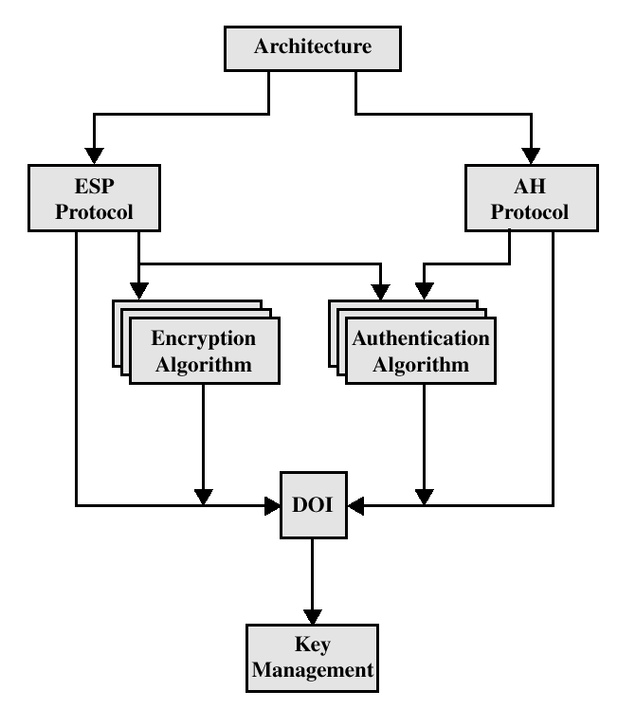
IPSec Document Overview

Slide 12
IPSec Services
Access Control
Connectionless integrity
Data origin authentication
Rejection of replayed packets
Confidentiality (encryption)
Limited traffic flow confidentiallity

Slide 13
Security Associations (SA)
A one way relationsship between a sender and a receiver.
Identified by three parameters:
  Security Parameter Index (SPI)
  IP Destination address
  Security Protocol Identifier

Slide 14
 | Transport Mode SA | Tunnel Mode SA
AH | Authenticates IP payload and selected portions of IP header and IPv6 extension headers | Authenticates entire inner IP packet plus selected portions of outer IP header
ESP | Encrypts IP payload and any IPv6 extesion header | Encrypts inner IP packet
ESP with authentication | Encrypts IP payload and any IPv6 extesion header. Authenticates IP payload but no IP header | Encrypts inner IP packet. Authenticates inner IP packet.

Slide 15
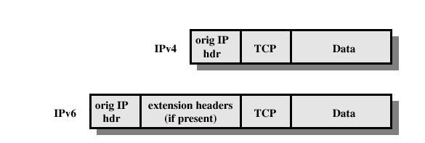
Before applying AH

Slide 16
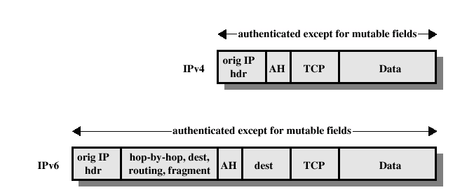
Transport Mode (AH Authentication)

Slide 17
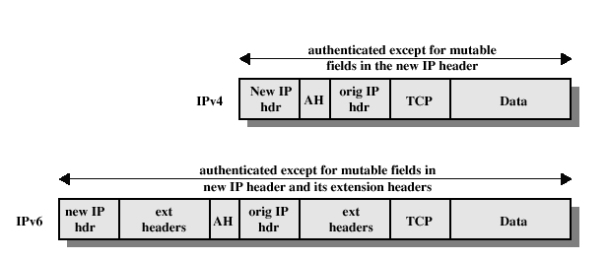
Tunnel Mode (AH Authentication)

Slide 18
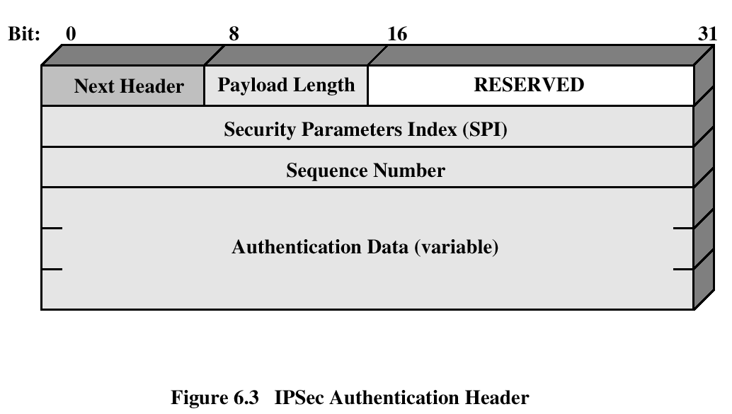
Authentication Header
Provides support for data integrity and authentication (MAC code) of IP packets.
Guards against replay attacks.

Slide 19
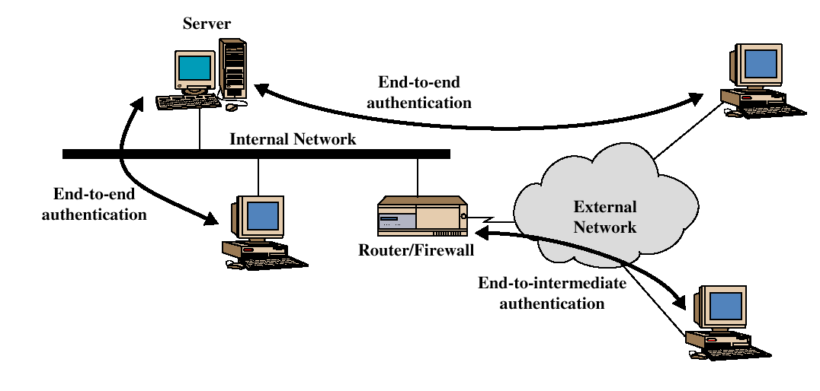
End-to-end versus End-to-Intermediate Authentication

Slide 20
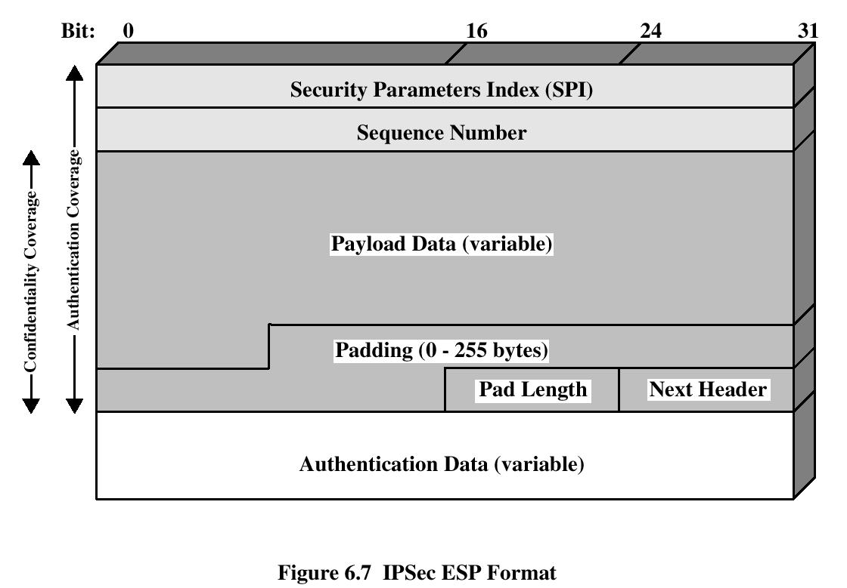
Encapsulating Security Payload
ESP provides confidentiality services

Slide 21
Encryption and Authentication Algorithms
Encryption:
  Three-key triple DES
  RC5
  IDEA
  Three-key triple IDEA
  CAST
  Blowfish
Authentication:
  HMAC-MD5-96
  HMAC-SHA-1-96

Slide 22
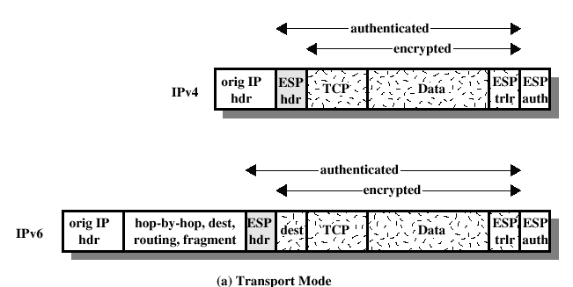
ESP Encryption and Authentication

Slide 23
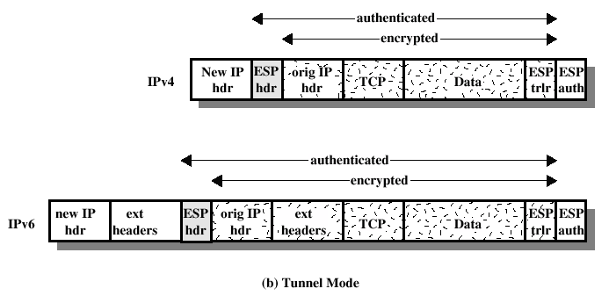
ESP Encryption and Authentication

Slide 24
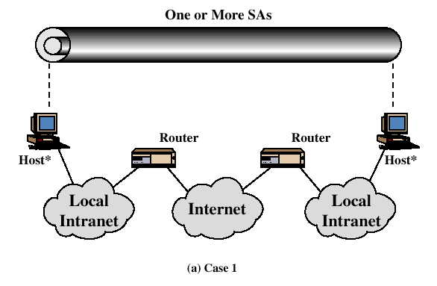
Combinations of Security Associations

Slide 25
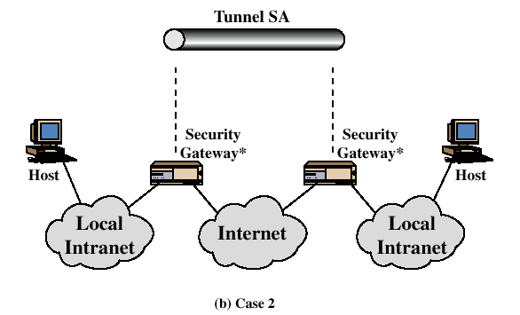
Combinations of Security Associations

Slide 26
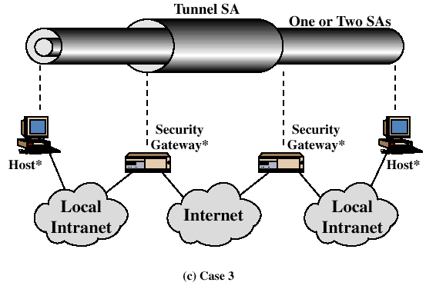
Combinations of Security Associations

Slide 27
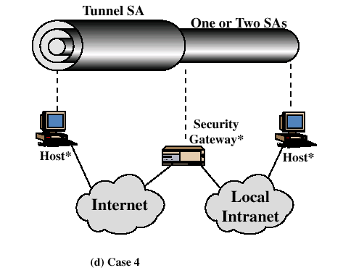
Combinations of Security Associations

Slide 28
Key Management
Two types:
  Manual
  Automated
    Oakley Key Determination Protocol
    Internet Security Association and Key Management Protocol (ISAKMP)

Slide 29
Oakley
Three authentication methods:
  Digital signatures
  Public-key encryption
  Symmetric-key encryption

Slide 30
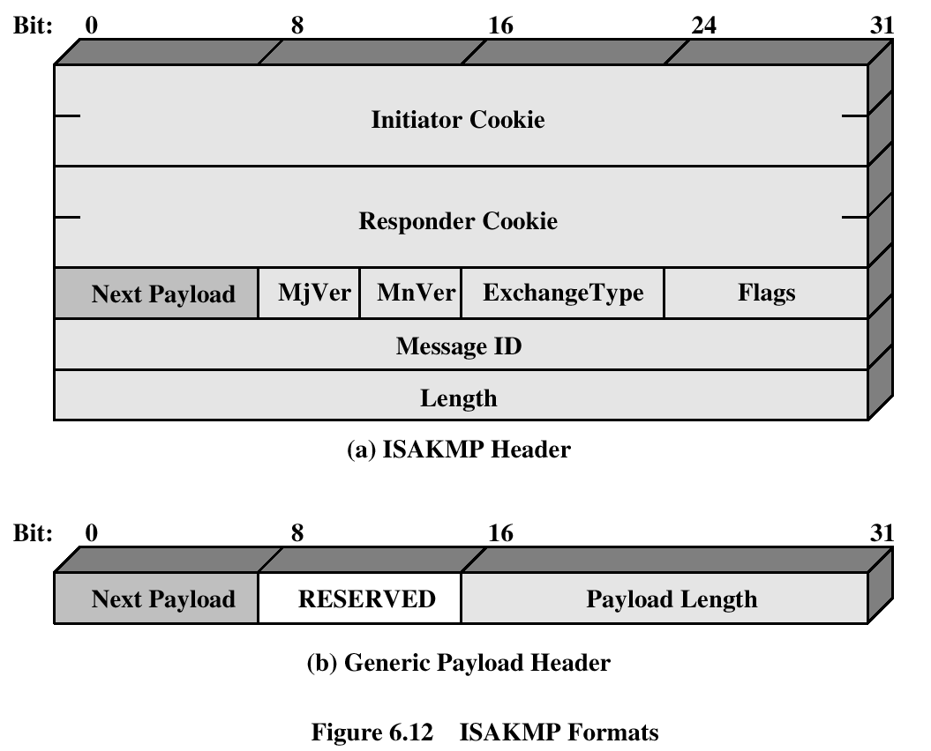
ISAKMP

Slide 31
Recommended Reading
Comer, D. Internetworking with TCP/IP, Volume I: Principles, Protocols and Architecture. Prentic Hall, 1995
Stevens, W. TCP/IP Illustrated, Volume 1: The Protocols. Addison-Wesley, 1994

